Slide 1
Meeting 29/11
Joren Janzing

Slide 2
Climate

Slide 3
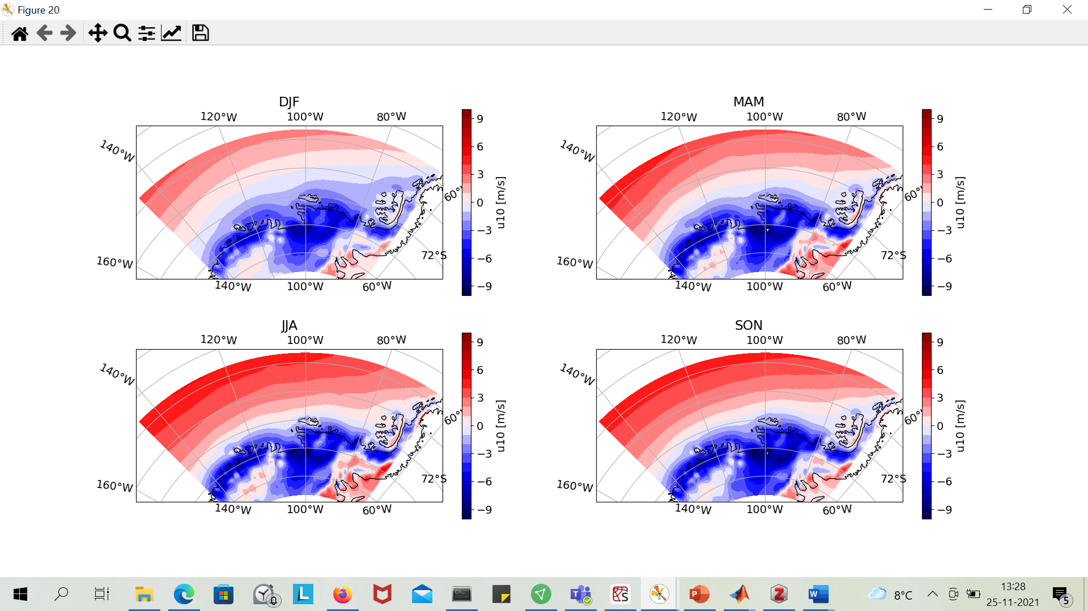
Steig et al., 2012: easterly in summer, westerly in rest of the year

Slide 4
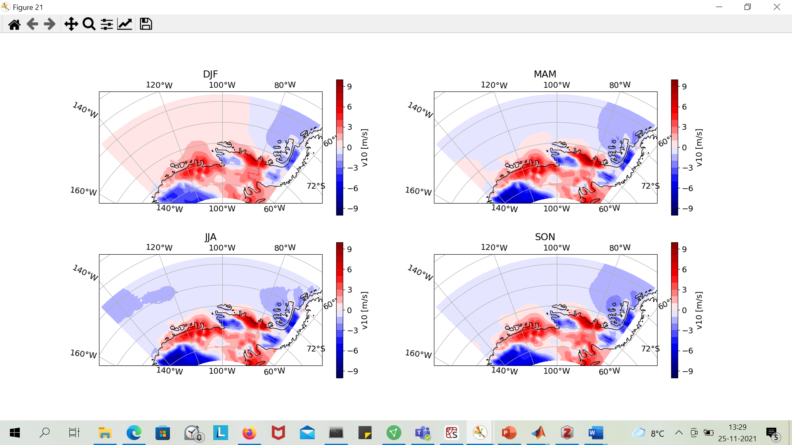

Slide 5
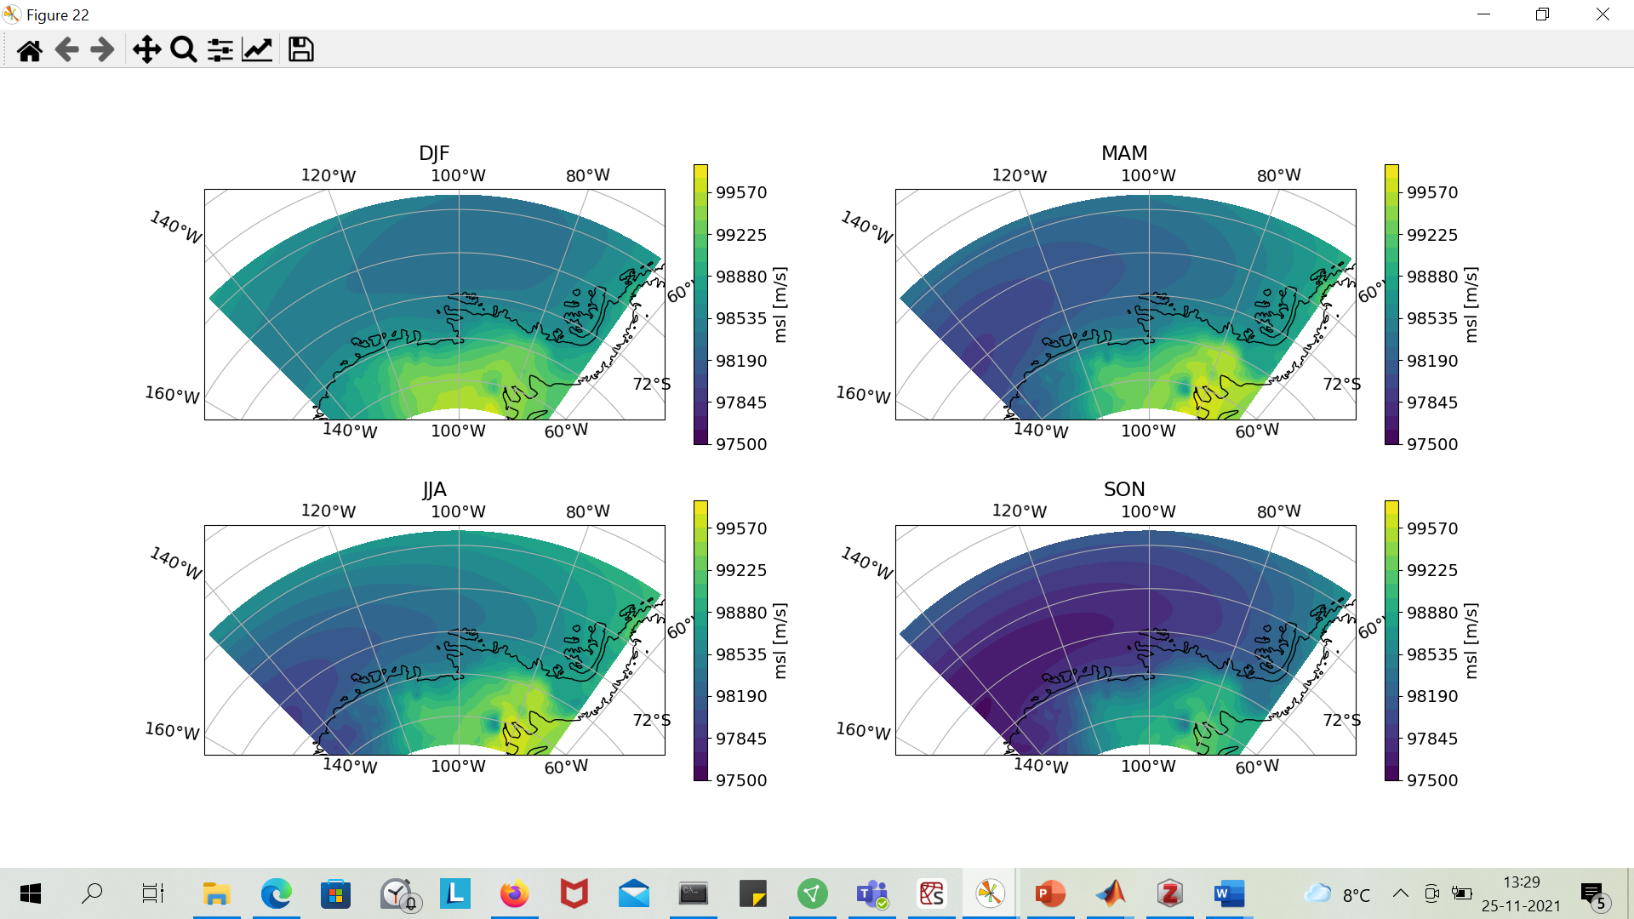

Slide 6
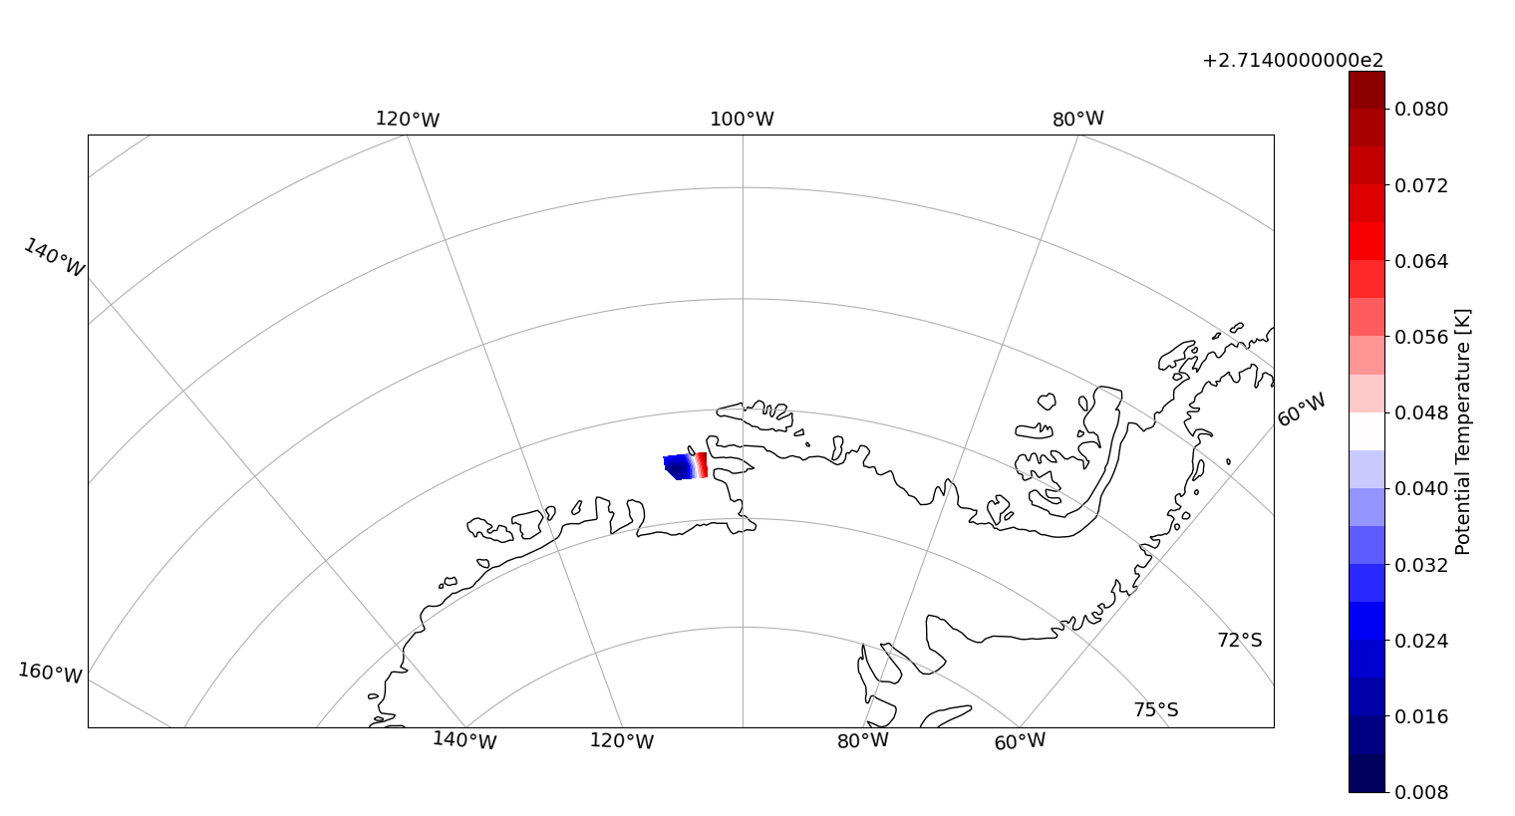
GODAS (https://psl.noaa.gov/data/gridded/data.godas.html)

Slide 7
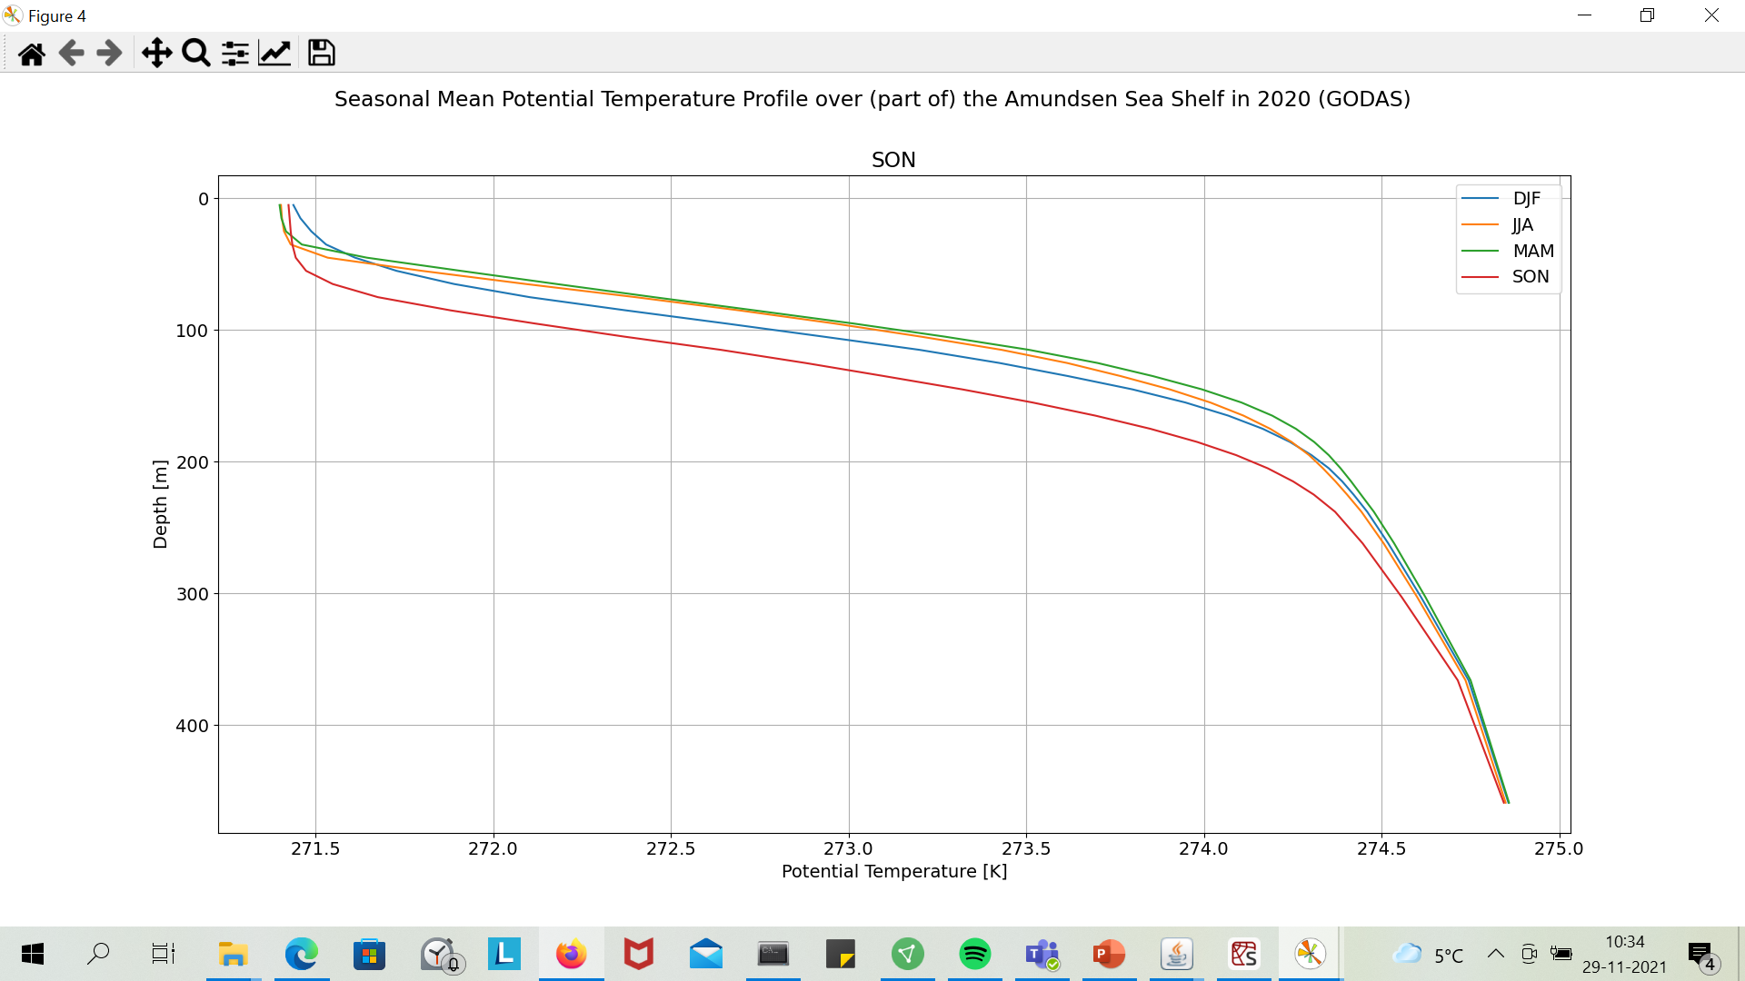
Seasonal changes in surface temperature?

Slide 8
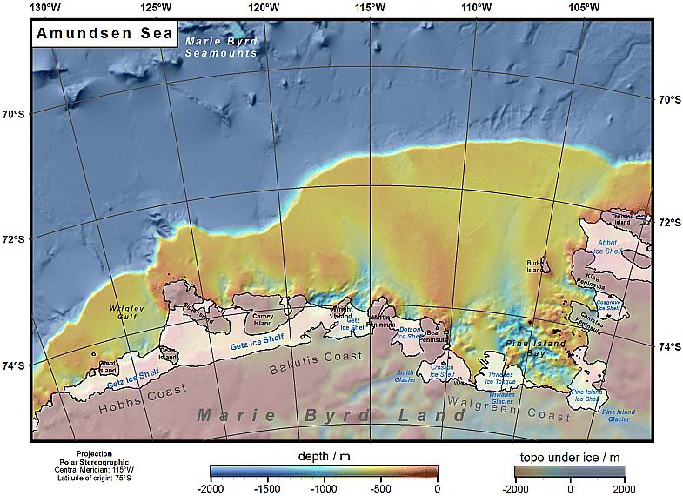
Nitsche, F. O., Jacobs, S. S., Larter, R. D., & Gohl, K. (2007). Bathymetry of the Amundsen Sea continental shelf: Implications for geology, oceanography, and glaciology. Geochemistry, Geophysics, Geosystems, 8(10).

Slide 9
Mechanisms of CDW

Slide 10
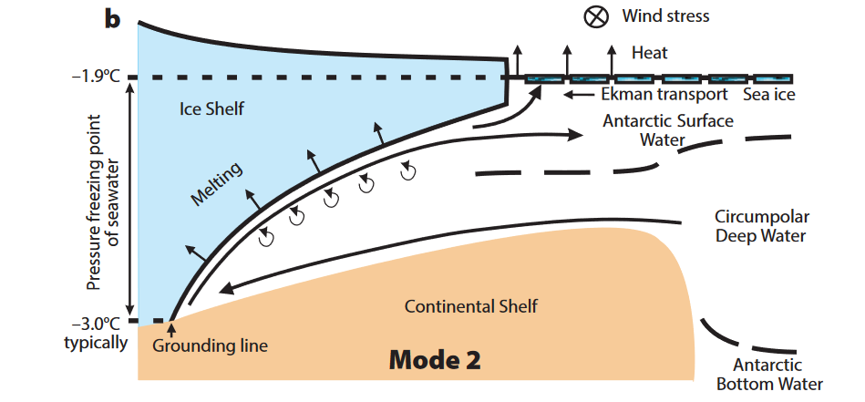
Mechanisms: 1 (Jenkins et al., 2016)

Slide 11
Mechanisms: 2 Simple explanation CDW import (Steig et al., 2012)
Westerly winds, Ekman to North (SH)
Piling up of water, geostrophy to east. (SH)
Bottom friction, Ekman to south (SH)
More complicated: shelfedge currents, spatially varying topography etc…

Slide 12
Controls

Slide 13
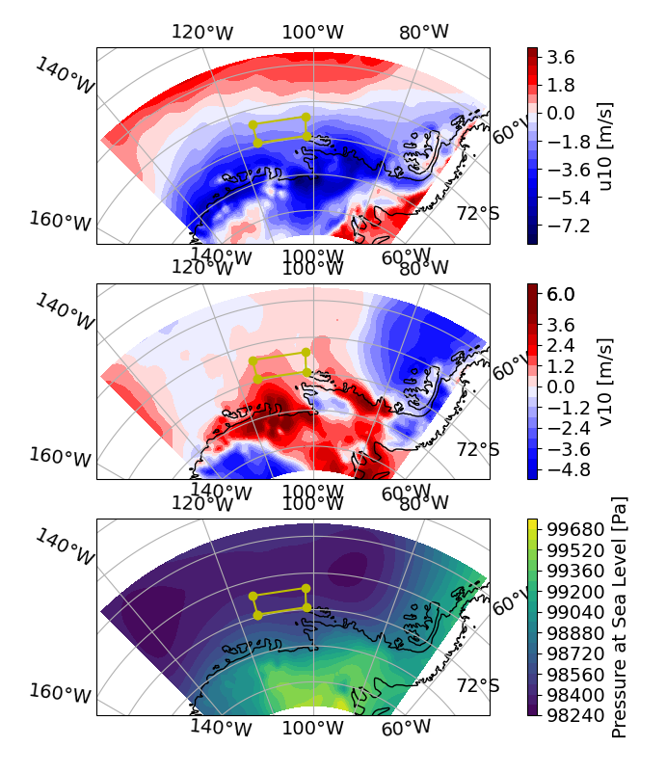

Slide 14
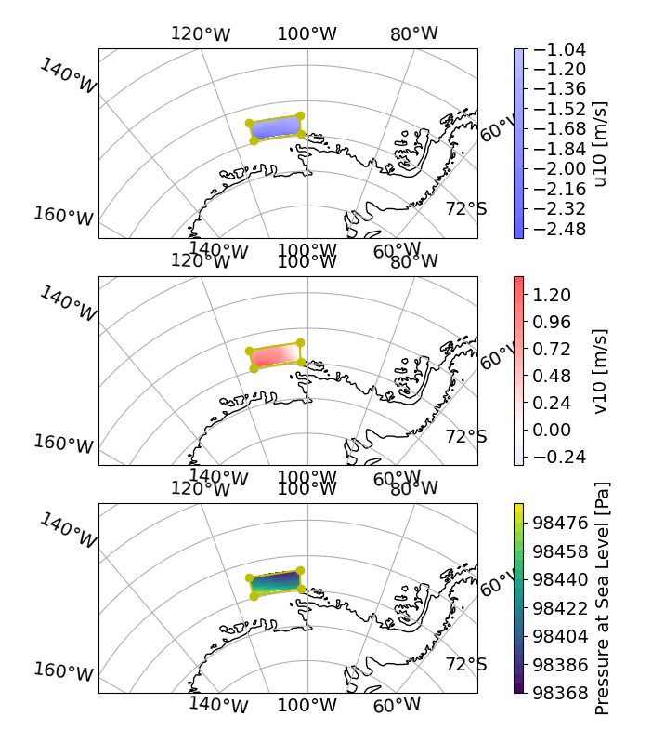

Slide 15
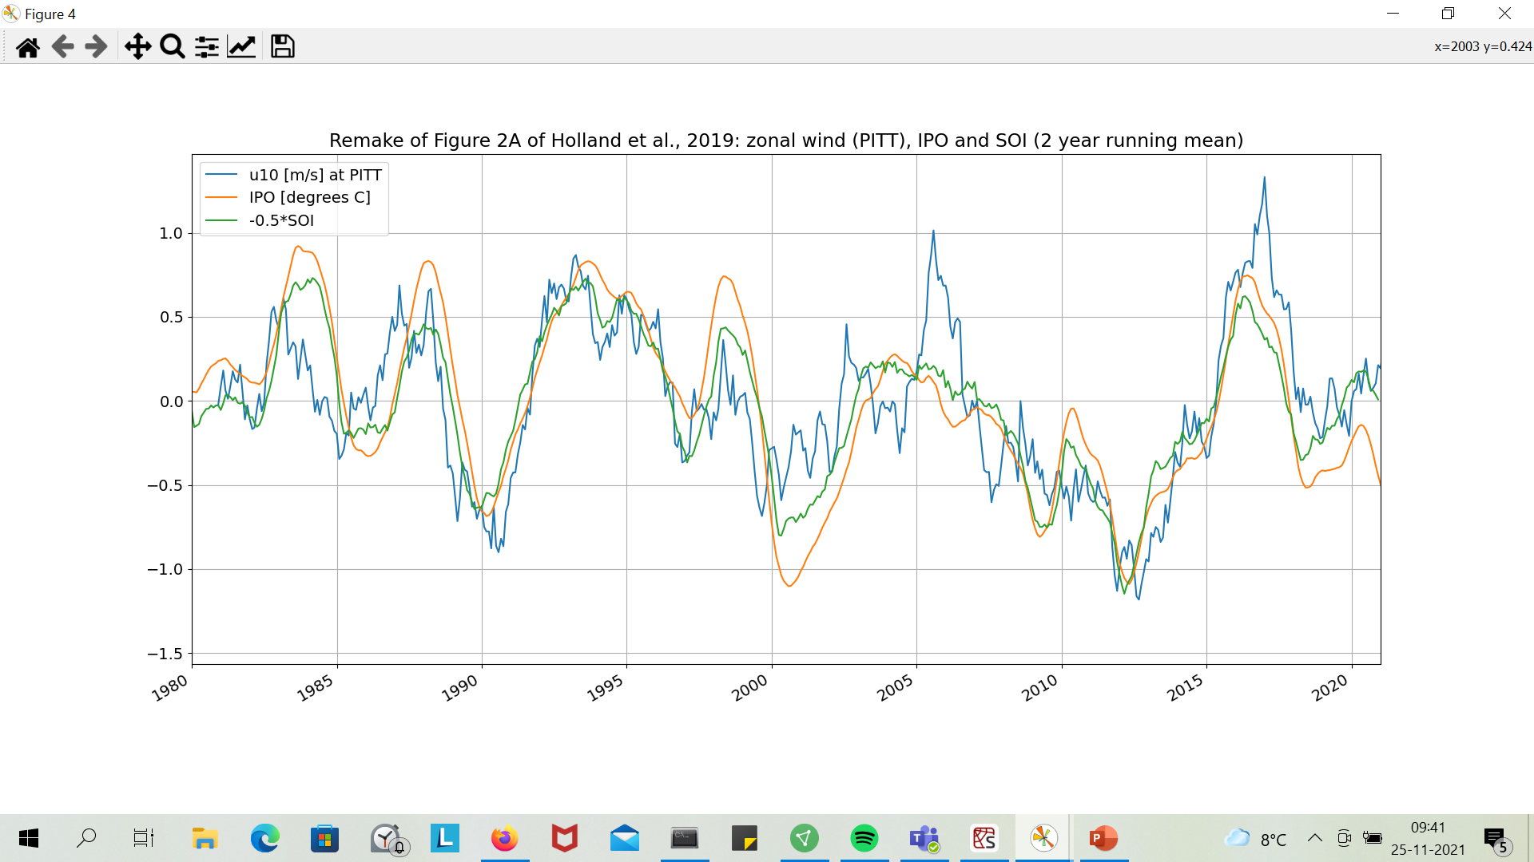
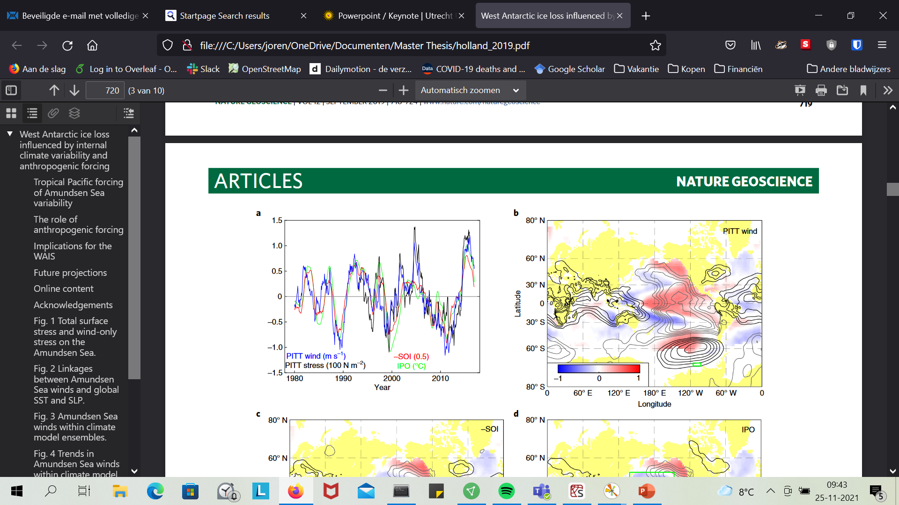
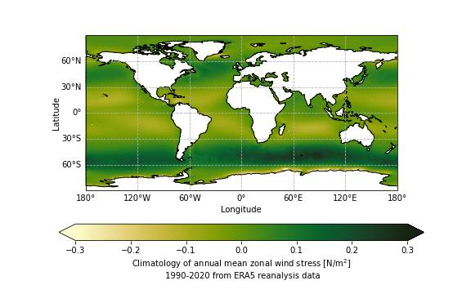
PITT winds and Climate Indices
Wind stress left out: very small, in Holland 100N/m^2→ mainly ice stress?
Wikipedia, Windstress
Fig 2a, Holland et al., 2019

Slide 16
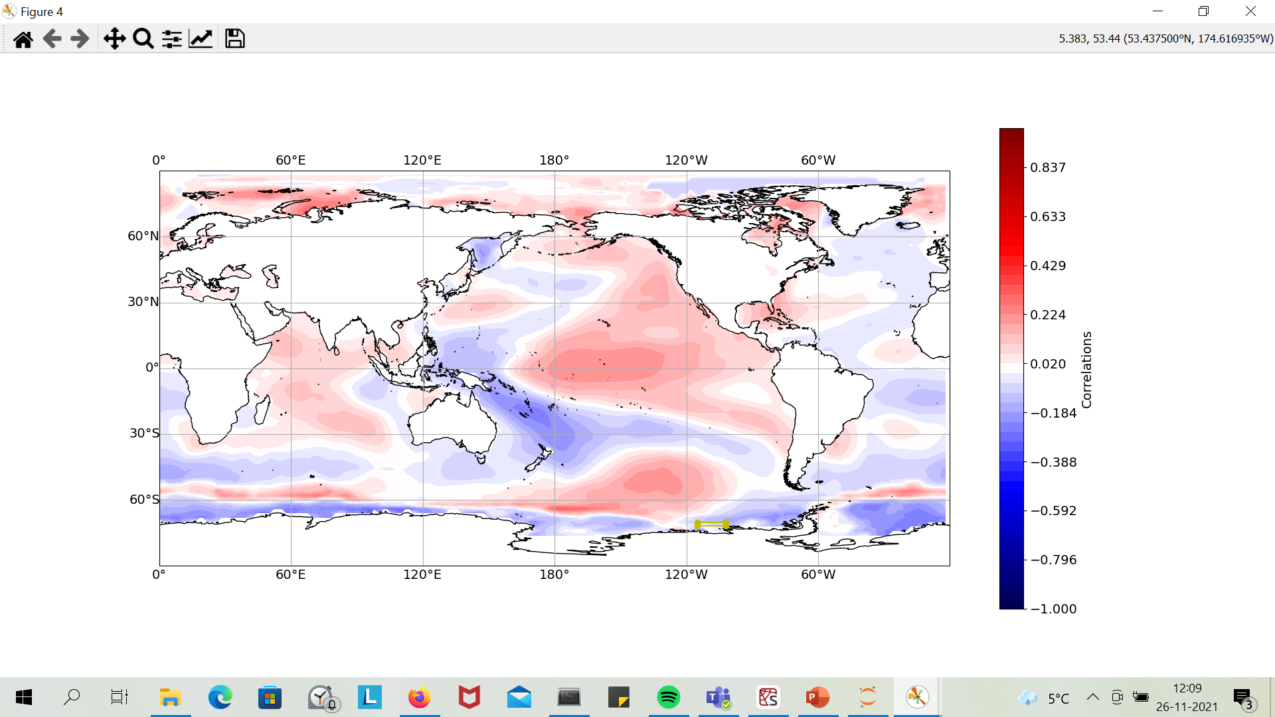
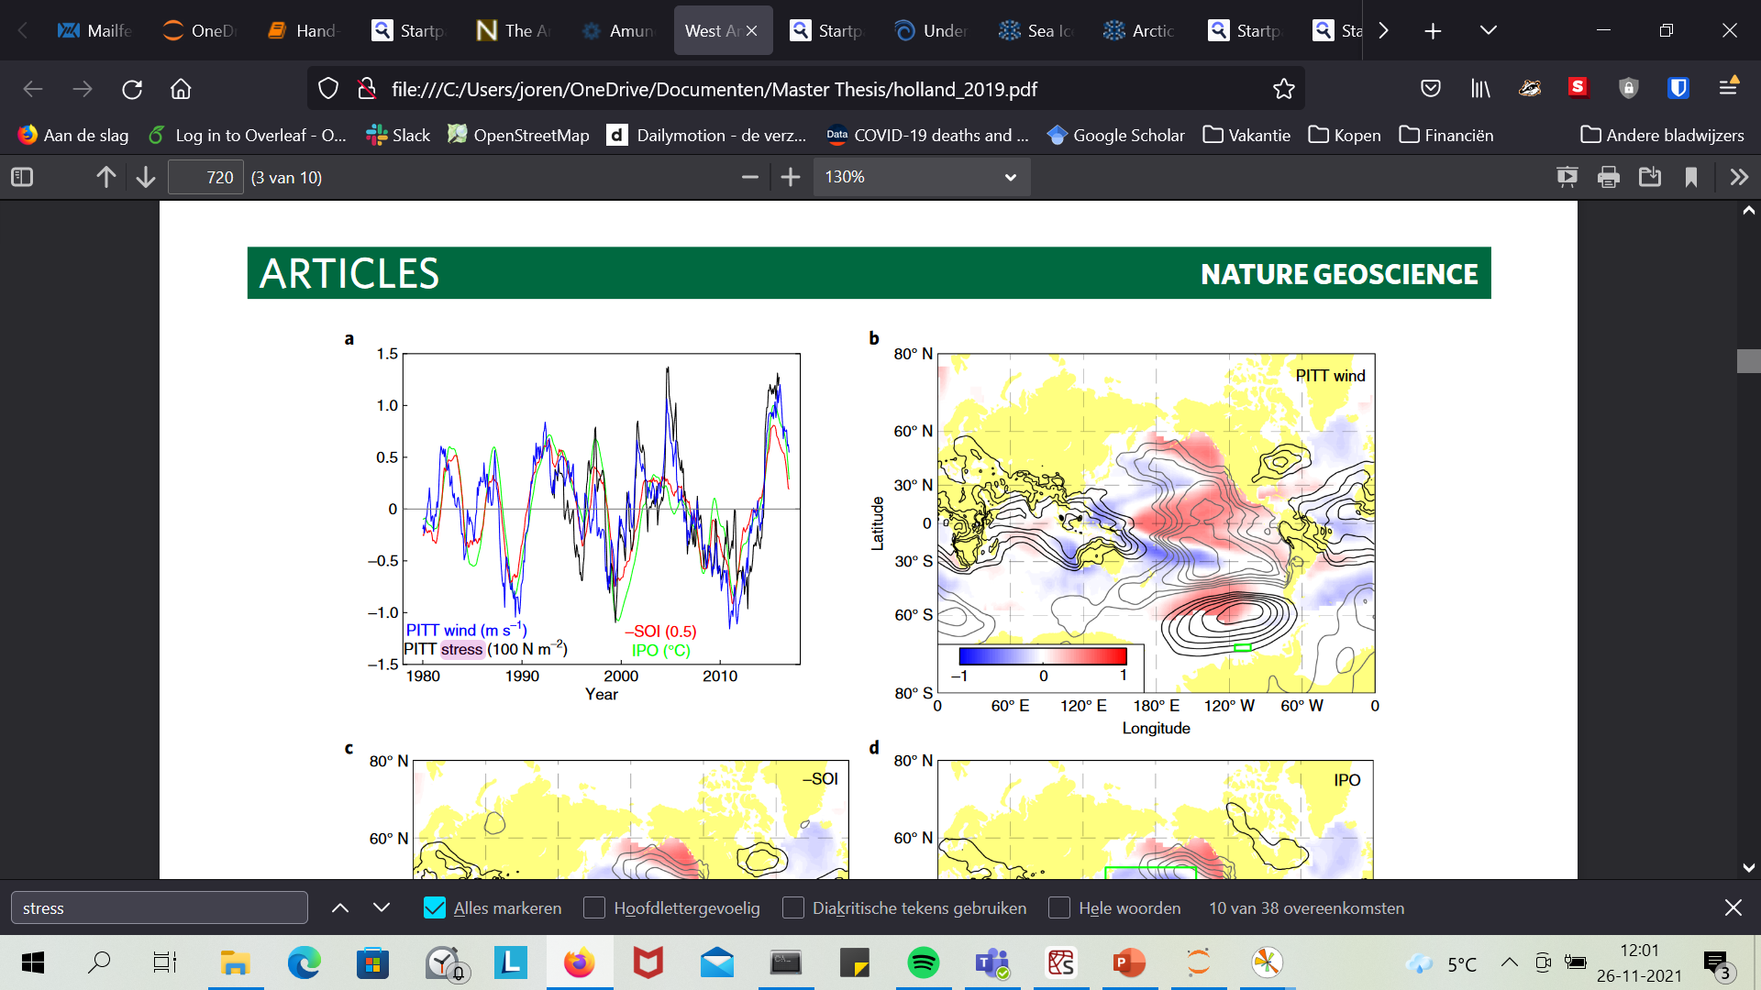
Correlation between PITT winds and SSTA (from ERSST)
Statistical significance left out in Holland?
SSTA anomaly corrected for climate change?
Projection

Slide 17
Indices
IPO: SSTA anomalies on Pacific; https://psl.noaa.gov/data/timeseries/IPOTPI/
SOI: pressure Tahiti-Darwin→ negative during El Niño!
MEI: Multivariate ENSO index: more holistic approach, first PC of SST, SLP, U, V, OLWR over the Pacific… https://psl.noaa.gov/enso/mei/
NINO 3.4: SSTA over the 3, 4 region https://psl.noaa.gov/gcos_wgsp/Timeseries/Nino34/
SAM: pressure 40 degrees-60degrees S→ negative winds towards equator https://psl.noaa.gov/data/20thC_Rean/timeseries/monthly/SAM/

Slide 18
What happened in the 1940s?

Slide 19
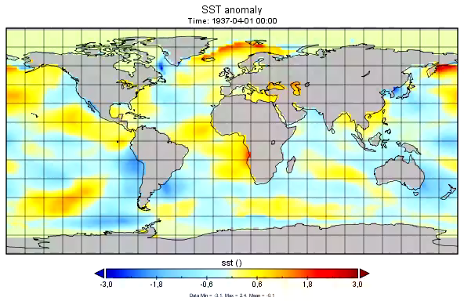
With respect to average over whole period→ Bias due to climate change

Slide 20
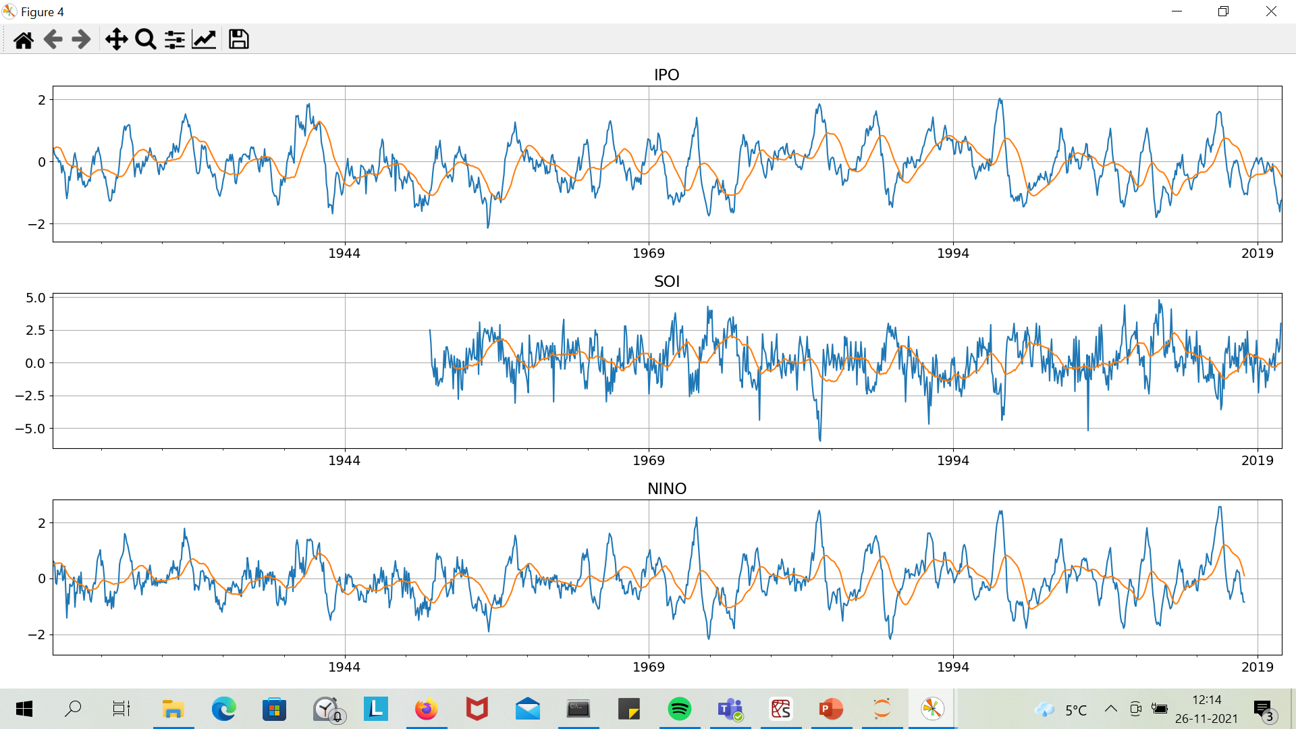

Slide 21
1940s ENSO effect on Ice

Slide 22
To Do:
Effect ENSO on ice, and correlation with thermocline?
More on 1940s?
Data from BAS?
Going to Cambridge→ document, housing?

Slide 23
Model

Slide 24
